Slide 1

NBA Player Clustering 2019-2020 NBA Season Tony Ramsett Data Practicum 2 Regis University

Slide 2



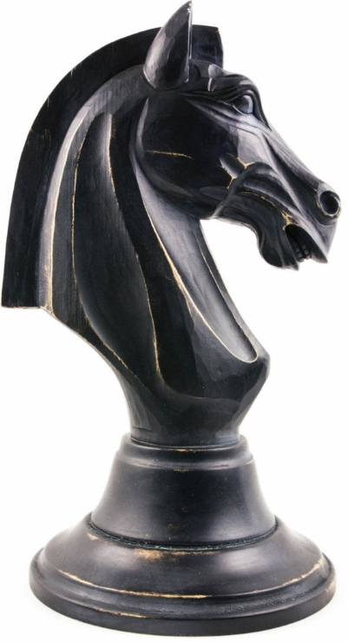
About Me
Occupation
Education
Consultant for a company that specializes in customer engagement and business performance
University of Colorado at Boulder
Major in Economic, Minor in Political Science
Data Reasoning
Recreation
Basketball fan my entire life
Followed NBA closely for 20+ years
Basketball/Football fan
Breweries
Learning Chess

Slide 3
Project Description
Project Objective
Data sets Used
Models Utilized
Research Question
How did NBA players overall performances from a statistical perspective compare during the 2019-2020 NBA season before the shutdown due to COVID-19?
Two Primary Data Sets Used
Traditional (Box Score) Statistics
Advanced Statistics
Additional Cluster Analyses (Appendix)
Scoring Statistics
Defensive Statistics
Unsupervised Learning Models
K-Means Clustering
Hierarchical Clustering Analysis
Principal Component Analysis
Supervised Learning Models
K-Nearest Neighbors (KNN)
(NBA shutdown on 03/10/20, play resumed on 07/30/20)

Slide 4
Project Timeline
8 week project spanning from 07/01/20 – 08/19/20 followed the Data Science Lifecycle
Week 1
Week 2
Week 3
Week 4
Week 5
Week 6
Week 7
Week 8
Business Understanding
Data Mining
Data Cleaning
Data Exploration
Feature Engineering
Predictive Modeling
Data Visualization

Slide 5
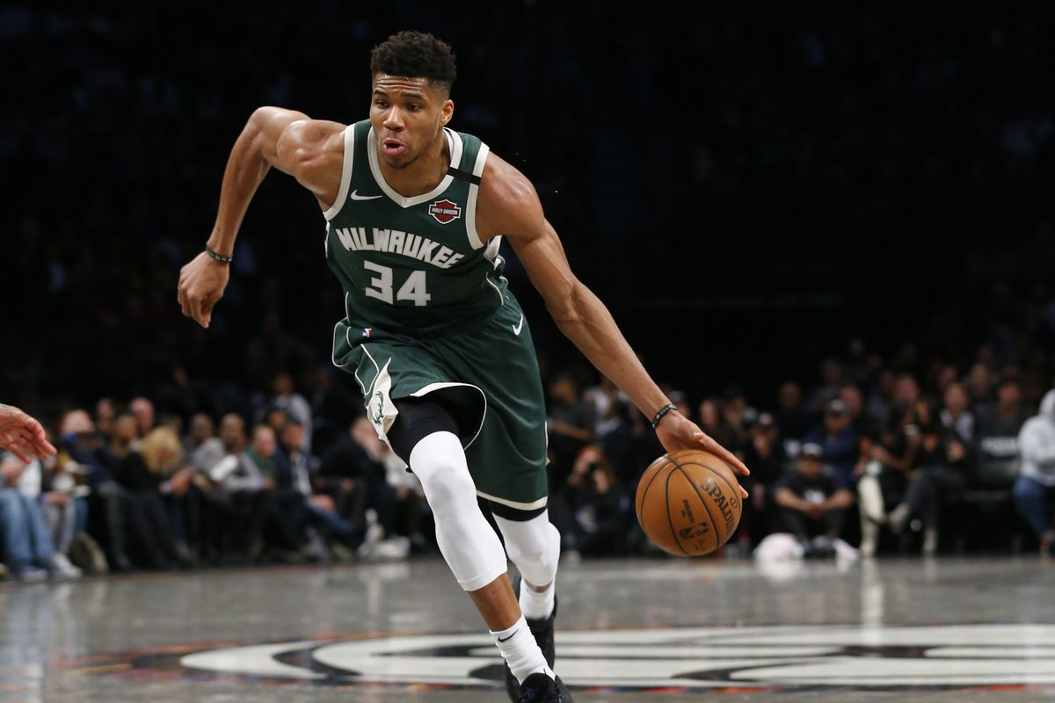
Overall Performance Clusters

Slide 6
Data Set Description
Two data sets were combined into one working data set for clustering and model analysis
Column Remains for Clustering| Column Removed and Not Used
Traditional Statistics Data Set
Data Set Dimensions: 514 rows x 30 columns
Advanced Statistics Data Set
Data Set Dimensions: 514 rows x 23 columns
Row Number
Player = Player Name
Team = Team Player Plays For
Age = Age of Player
GP = Games Played
W = Team Wins
L = Team Losses
MIN = Minutes Played Per Game
PTS = Points Scored Per Game
FGM = Field Goals Made
FGA = Field Goals Attempted
FG. = Field Goal Percentage
X3PM = 3 Pointers Made
X3PA = 3 Pointers Attempted
x3P. = 3 Point Percentage
FTM = Free Throws Made
FTA = Free Throws Attempted
FT. = Free Throw Percentage
OREB = Offensive Rebounds
DREB = Defensive Rebounds
REB = Total Rebounds Per Game
AST = Assists
TOV = Turnovers
STL = Steals
BLK = Blocks
PF = Personal Fouls
FP = Fantasy Points
DD2 = Double-Doubles
TD3 = Triple-Doubles
Plus_Minus = Plus/Minus
Row Number
Player = Player Name
Team = Team Player Plays For
Age = Age of Player
GP = Games Played
W = Team Wins
L = Team Losses
MIN = Minutes Played Per Game
OFFRTG = Offensive Rating
DEFRTG = Defensive Rating
NETRTG = Net Rating
AST. = Assist Percentage
AST.TO = Assist to Turnover Ratio
ASTA.Ratio = Assist Ratio
OREB. = Offensive Rebound Percentage
DREB. = Defensive Rebound Percentage
REB. = Rebound Percentage
TOA.Ratio = Turnover Ratio
eFG. = Effective Field Goal Percentage
TS. = True Shooting Percentage
USG. = Usage Percentage
PACE = Pace
PIE = Player Impact Estimate
Data Cleaning
Data set contained 0 NA values, Data narrowed down to top 100 players by minutes played (> 29.35 minutes per game, All data values normalized for cluster accuracy
Feature Engineering
No additional columns added to data set
Final Data Set Dimensions
100 rows x 34 columns

Slide 7
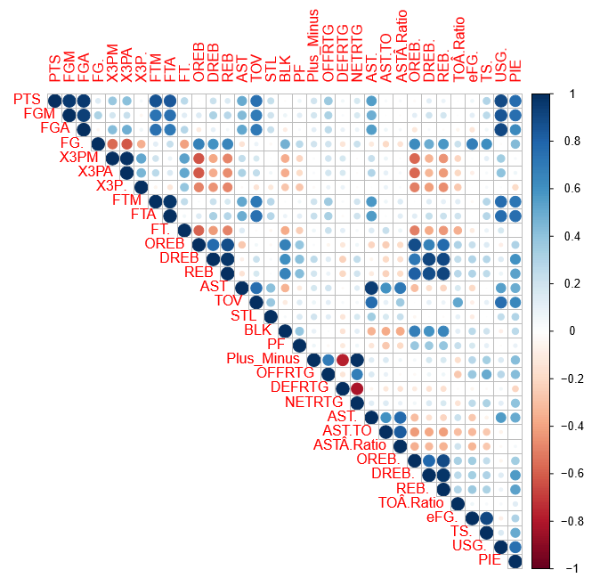
Correlation Plot
The correlation plot shows logical and unsurprising correlations between variables within the data set
Understanding Correlation Plots
Library in R
The darker the blue circle = the more positive the correlation is between variables
The darker the red circle = the more negative the correlation is between variables
Takeaways
Field Goals Made/Attempted and Free Throws Made/Attempted show a positive correlation
3 Pointers Made/Attempted/Percentage have a negative correlation with Offensive/Defensive Rebounds
Rebound Totals positively correlated with Rebound Percentages
Plus_Minus correlations with Offensive/Defensive/Net Rating are logical

Slide 8
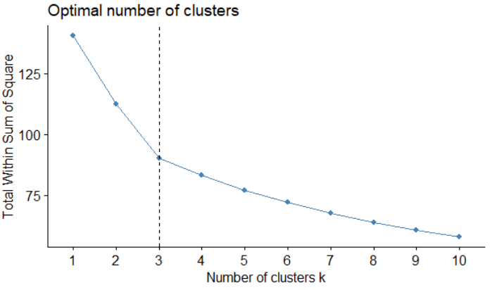
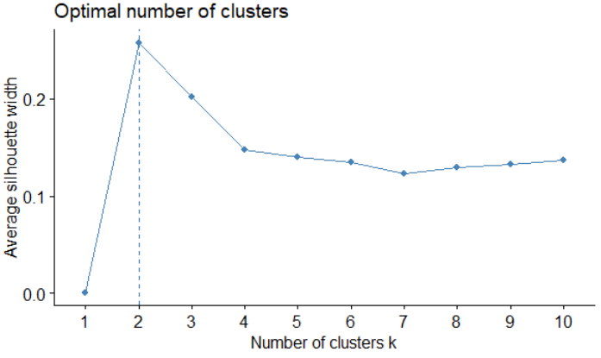
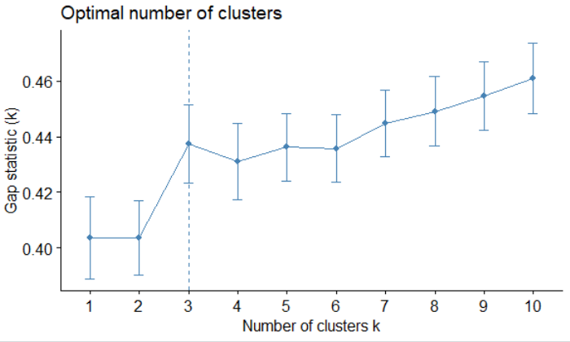
Cluster Optimization
Various methods exist to determine the optimal number of clusters to be used for clustering models
Elbow Method
Silhouette Method
Gap Statistic Method
The sum of squares at each number of clusters is calculated and plotted. The change in slope, ‘elbow’, indicates the optimal number of clusters
The average silhouette observations for different numbers of clusters is calculated. The optimal number of clusters is where the average silhouette is maximized
The total intra-cluster variation for different numbers of clusters are compared. The dashed line shows the optimal number of clusters
Optimal clusters: 3
Optimal clusters: 2
Optimal clusters: 3
3 total clusters will be used for this analysis. The Elbow Method and Gap Statistic Method both show that three is the optimal number to be chosen

Slide 9
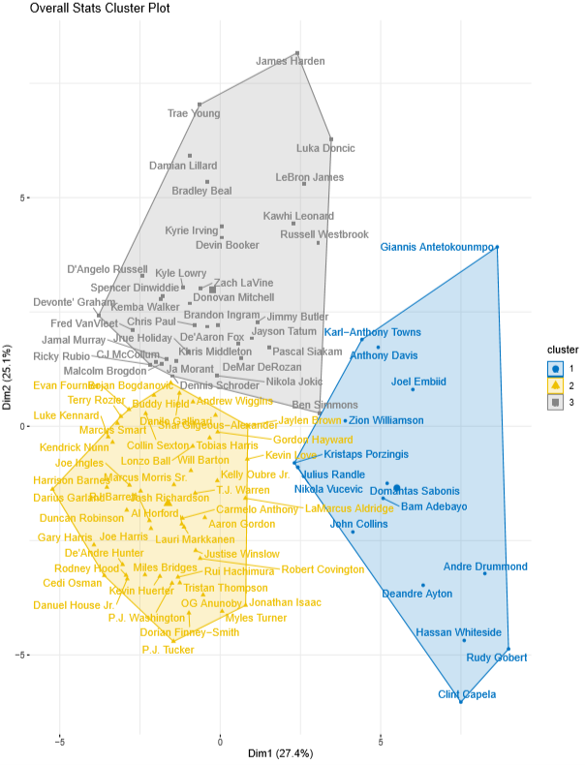
K-Means Clustering
4
Without surprise, the algorithm clustered players primarily on the position that they play
2
Understanding K-Means Clustering
Unsupervised learning algorithm where no labels for the data exist
Divide the data into k number of clusters, determined by the user
An iterative process measures distances between data points and subsequently the centroid for each cluster
Distances between data points is determined by the sum of squares
1
Plot Insights
Cluster 1 contains 16 players, Cluster 2 contains 49 players, and Cluster 3 contains 35 players
Giannis Antetokounmpo separates himself in Cluster 1 – a group defined by taller players who score and rebound frequently
All players are closely packed together in Cluster 2 – no player separates himself from the rest
James Harden separates himself in Cluster 3 and nine other players separate themselves from the rest of the cluster, all nine of which were 2020 All-Stars
3
1
2
3
4
Source: https://www.simplilearn.com/tutorials/machine-learning-tutorial/k-means-clustering-algorithm, https://indiaai.in/article/how-k-means-clustering-works

Slide 10
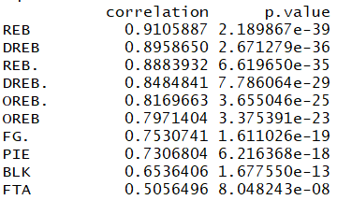
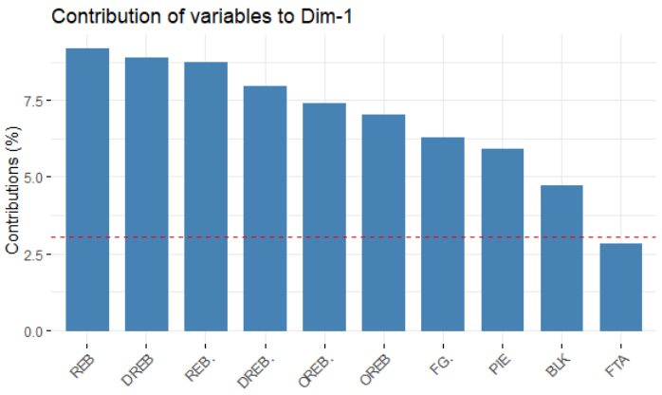
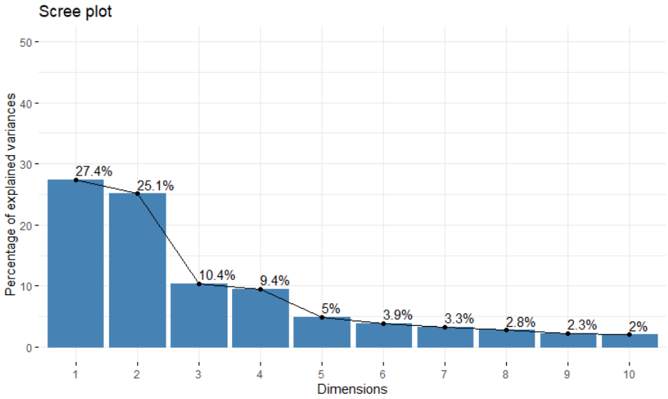
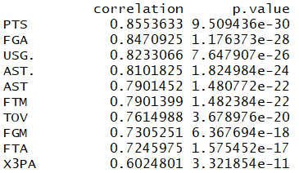
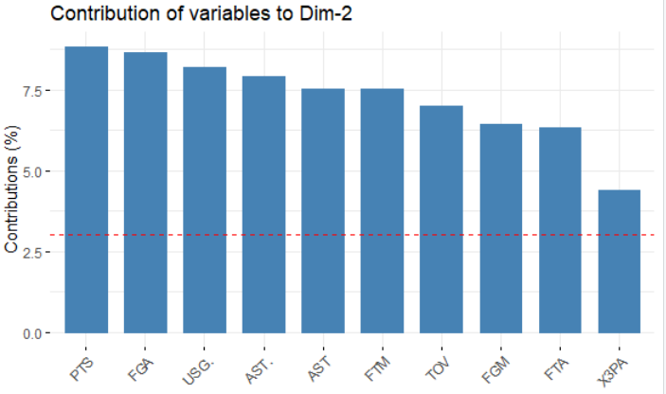
Principal Component Analysis (PCA)
PCA is used to reduce dimensionality of a data set by using linear combinations of the variables which are called principal components
Understanding Scree Plots
Show explained variance percent (eigenvalue) per principal component (dimension)
Number of principal components to use determined by the point at which the eigenvalues level out, meaning they are relatively small and comparable in size
In this case, use up to 4 principal components to analyze the data
The top ten contributing variables within Dimension 1
The top ten contributing variables within Dimension 2
Source:www.sthda.com/english/articles/31-principal-component-methods-in-r-practical-guide/112-pca-principal-component-analysis-essentials/, https://aaronschlegel.me/principal-component-analysis-r-example.html

Slide 11
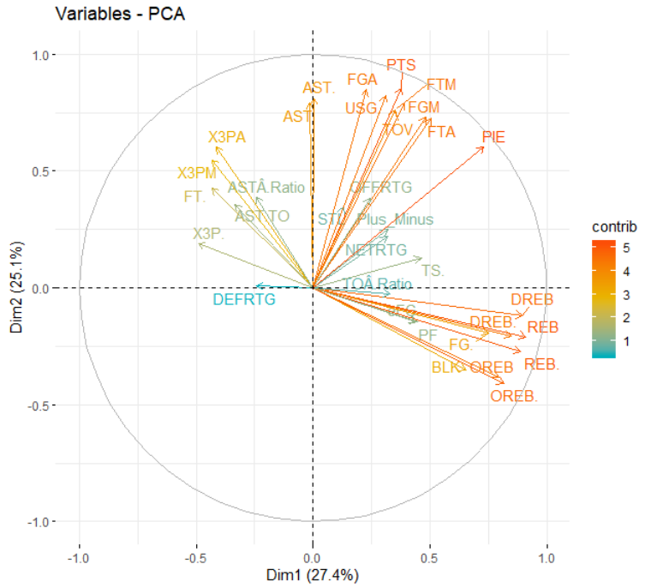
Principal Component Analysis (PCA)
Correlation circles show the contributions of variables as well as relationships between the variables
Understanding Correlation Circles
The correlation between a variable and a principal component is used as the coordinates of the variable on the PC.
High contribution values represent a good representation of the variable and are positioned closer to the circumference of the circle and vice versa
Positively correlated variables are grouped together whereas negatively correlated variables are positioned on opposite sides of the plot
Variable Insights
Several orange variables, specifically centered around Field Goals, Free Throws, and Efficiency metrics
Yellow variables contain statistics such as 3 pointers made and attempted as well as Assists statistics
Teal variables centered around ratings such as offensive, defensive, and net
www.sthda.com/english/articles/31-principal-component-methods-in-r-practical-guide/112-pca-principal-component-analysis-essentials/

Slide 12
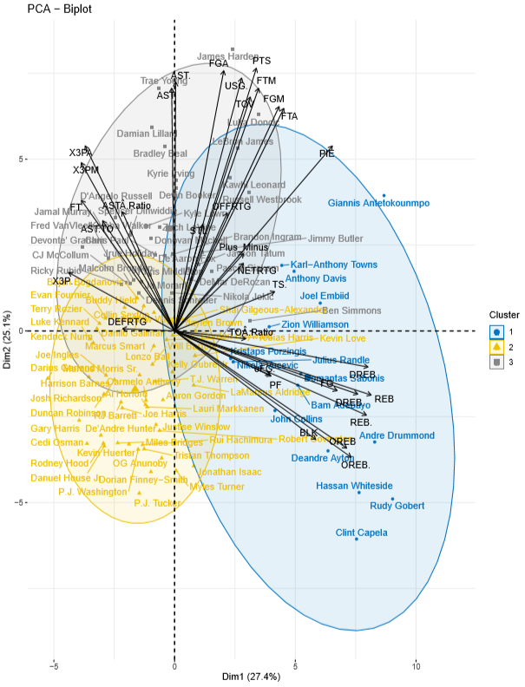
Principal Component Analysis (PCA)
Biplots help to show where players and variables land on the plot simultaneously
Understanding Biplots
Same cluster plot as K-Means Cluster Plot
Coordinates of players and variables are not constructed on same space.
Focus on direction of variables, not on position of variables
If player is on same side as a variable, then the player has a higher value for that variables.
Alternatively, if player is on opposite side as a variable, then player has low value for that variable
Biplot Insights
Players in the top left are three point shooters and efficient ball handlers
Players in the top right score often and account for the team wins
Players in the bottom right are the rebounders who also block shots and foul the most
No major contributing variables for players in the bottom left
Source: http://www.sthda.com/english/articles/31-principal-component-methods-in-r-practical-guide/112-pca-principal-component-analysis-essentials/

Slide 13
Cluster Insights
Statistical Summary
Highest Value | Middle Value | Lowest value
Statistic Category | Cluster 1 | Cluster 2 | Cluster 3
Points Scored | 20.39 | 14.69 | 22.65
Field Goals Made | 7.78 | 5.39 | 7.93
Field Goals Attempted | 14.61 | 12.01 | 17.22
Field Goal Percentage | 54% | 45% | 46%
3 Pointers Made | 0.91 | 1.84 | 2.21
3 Pointers Attempted | 2.60 | 4.95 | 6.15
3 Pointer Percentage | 27% | 37% | 35%
Free Throws Made | 3.93 | 2.06 | 4.61
Free Throws Attempted | 5.51 | 2.61 | 5.59
Free Throw Percentage | 71% | 79% | 82%
Offensive Rebounds | 3.00 | 1.05 | 0.89
Defensive Rebounds | 8.54 | 4.23 | 4.53
Total Rebounds | 11.54 | 5.27 | 5.41
Assists | 2.95 | 2.69 | 6.33
Turnovers | 2.49 | 1.66 | 2.98
Steals | 0.93 | 0.91 | 1.23
Blocks | 1.46 | 0.54 | 0.42
Personal Fouls | 2.90 | 2.33 | 2.37
Plus/Minus | 2.16 | -0.19 | 2.09
Assist/Turnover Ratio | 1.18 | 1.65 | 2.27
Assist Ratio | 12.73 | 15.63 | 22.64
Offensive Rebound Percentage | 9% | 3% | 2%
Defensive Rebound Percentage | 25% | 13% | 12%
Rebound Percentage | 17% | 8% | 7%
Turnover Ratio | 11.24 | 9.61 | 10.17
Effective Field Goal Percentage | 57% | 53% | 52%
True Shooting Percentage | 60% | 56% | 57%
Cluster Descriptions
Cluster 1 – “Low-Post Bullies”
Take high percentage shots with a high propensity for dunks
Poor 3 pointer and free throw shooters
Aptitude to rebound regularly
Motivation to block shots
2020 All-Stars - 6/16 players (37.5%)
Cluster 2 – “Rising Stars”
Do a bit of everything – not a score first mentality
Lowest rebound percentage
Do not shoot often from close or long range
Security with lowest turnover and personal foul rates
2020 All-Stars – 0/49 players (0%)
Cluster 3 – “Primetime Performers”
Shoot the ball frequently both from close and long range
Take several free throws per game with high success percentage
Involve others in offense with high assists
Lowest rebound percentage
2020 All-Stars – 19/35 players (54.3%)
Source - https://www.nba.com/allstar/2020/roster#/
All values represent averages between players within the cluster per statistic category

Slide 14
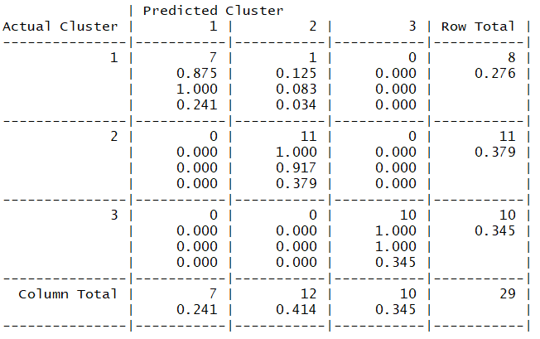
K-Nearest Neighbor (KNN)
KNN is a supervised machine learning algorithm that classifies data points based on the features of k-nearest data points
Hypothesis Testing
Confusion Matrix Results
H0: There is no significant difference between clusters
H1: There is a significant difference between clusters
Model Setup
Nearest Neighbors (k) = 10
k = 10 (square root of records in data set = 10, 100 total players in data set)
Training data = 70 players, Test data = 30 players
Model Results
P-value = 3.242e-10
Accuracy = 96.55%
Reject the Null Hypothesis (H0): Alpha (0.05) > P-Value
All players within Cluster 2 and 3 were accurately predicted by the KNN Model where k = 10. One player was mis-classified in Cluster 1 (Rudy Gobert)

Slide 15
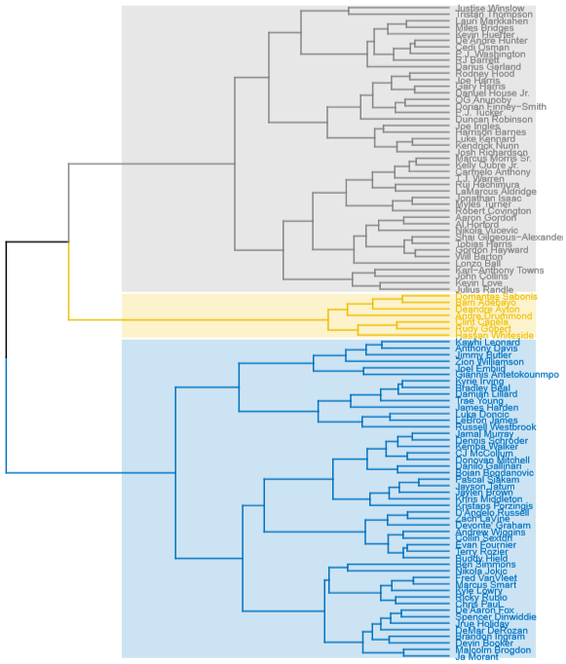
Hierarchical Cluster Analysis (HCA)
1
HCA allows to easily see how data compares and relates to each other most commonly through the use of dendrograms
Understanding Dendrograms
Two methods to separate data – agglomerative and divisive
Do not need to choose number of clusters to be utilized
Data separated by distance method chosen by user then can visualize how data relates each other
Tree based representation of the data opposed to a cluster plot visual
2
3
Dendrogram Insights
4
1
A group of accurate three-point shooters, notably Joe Harris, P.J. Tucker, and Duncan Robinson
Only half of the ‘Low-Post Bullies’ from the previous cluster analysis remain together here
Zion Williamson is in great company with Jimmy Butler, Anthony Davis, and Kawhi Leonard
Luka Doncic most closely linked to LeBron James – Great news for Mavericks fans
Ben Simmons and Nikola Jokic are a logical but unexpected match
2
3
5
4
5
Sourcehttps://uc-r.github.io/hc_clustering

Slide 16
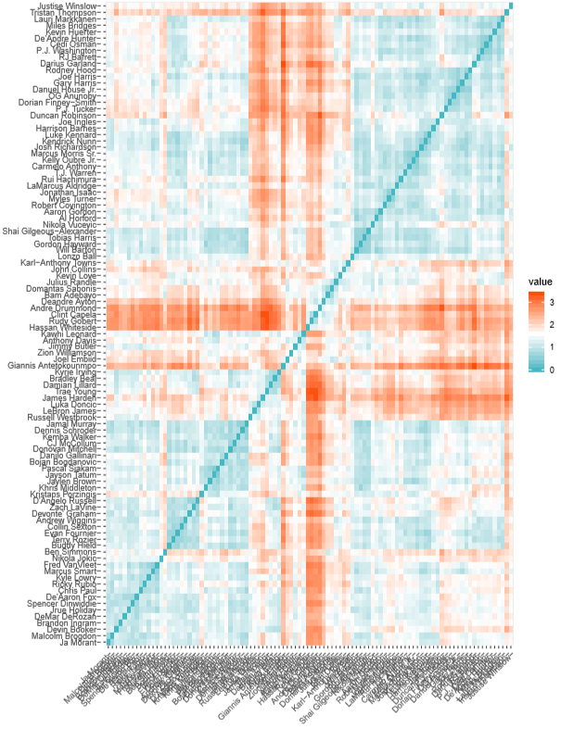
Hierarchical Cluster Analysis (HCA)
Distance matrices exist to quickly grasp how data relates to each through the use of a heatmap style format
Understanding Distance Matrices
Shows how data relates to each other in heatmap style format
Values closer to zero indicate data objects are similar whereas higher values indicate greater dis-similarity
Various methods exist to calculate distances between objects

Slide 17

Conclusion

Slide 18
Conclusions
Notable NBA stars missing from this data set due to injuries such as Kevin Durant, Steph Curry. Draymond Green, and Klay Thompson
Would have liked more than 3 clusters, but cant change story of data. This potentially could have allowed to distinguish players better within position groups
Learned a lot in these eight weeks about unsupervised learning and clustering techniques
So much more to learn and looking forward to building on what I have learned following this course

Slide 19
Clustering Methods Pro and Cons
There were several takeaways and lessons learned from the clustering methods performed for this project
Pro’s
Cons
K-Means Clustering
Easy to code and visualize
Choosing the optimal number of clusters is no simple task
Principal Component Analysis
Provides insightful outputs to better understand the data
Lots of time invested into understanding inner workings of how it works
Hierarchical Clustering Analysis
Dendrograms provide a clean, simple visual that show data that best intra-cluster relationships
The distance/similarity values calculated are not intuitive

Slide 20

The End
Questions?

Slide 21
References
All NBA pictures in deck found in ‘Images’ section on Google.com

Slide 22
Github Link
https://github.com/ramsetta/NBAPlayerClustering

Slide 23

Appendix

Slide 24

Offensive Scoring Clusters

Slide 25
Data Set Description
Column Used for Clustering | Column Removed
Data Set Dimensions: 514 rows x 27 columns
Row Number
Player = Player Name
Tm = Team Player Plays For
Age = Age of Player
G = Games Played
MP = Total Minutes Played
FG. = Field Goal Percentage
Dist. = Average distance (feet) of Field Goal Attempted
X2P_X.of.FGA.by.Distance = Percent of Two-Point Field Goals Attempted
X0.3P_X.of.FGA.by.Distance = Percent of Field Goals Attempted From 0-3 Feet
X3.10P_X.of.FGA.by.Distance = Percent of Field Goals Attempted From 3-10 Feet
X10.16P_X.of.FGA.by.Distance = Percent of Field Goals Attempted From 10-16 Feet
X16.3P_X.of.FGA.by.Distance = Percent of Field Goals Attempted From 16-30 Feet
X3P_X.of.FGA.by.Distance = Percent of Three-Point Field Goals Attempted
X2P_FG.by.Distance = Percent of Two-Point Field Goals Made
X0.3_FG.by.Distance = Percent of Field Goals Made From 0-3 Feet
X3.10_FG.by.Distance = Percent of Field Goals Made From 3-10 Feet
X10.16_FG.by.Distance = Percent of Field Goals Made From 10-16 Feet
X16.3P_FG.by.Distance = Percent of Field Goals Made From 16-30 Feet
X3P_FG.by.Distance = Percent of Three-Point Field Goals Made
X2P_of.FG.Ast’d = Percent of Two-Point Field Goals Made With Assist
X3P_of.FG.Ast’d = Percent of Three-Point Field Goals Made With Assist
X.FGA_Dunks = Percent of Dunks Attempted
X_Dunks = Number of Dunks Made
X.3PA_Corner.3s = Percent of Corner 3’s Attempted
X3P._Corner.3s = Percent of Corner 3’s Made
Adjustments
Data Cleaning
Data set contained 467 NA values
Converted to values of ‘0’
Data narrowed down to top 100 players by minutes played (G/MP > 29.35 minutes per game) for cluster analysis
All data values normalized for cluster accuracy
Feature Engineering
Minutes Per Game (G/MP) used for sub-setting then removed
Final Data Set Dimensions
100 rows x 21 columns
Source: https://www.basketball-reference.com/leagues/NBA_2020_shooting.html

Slide 26
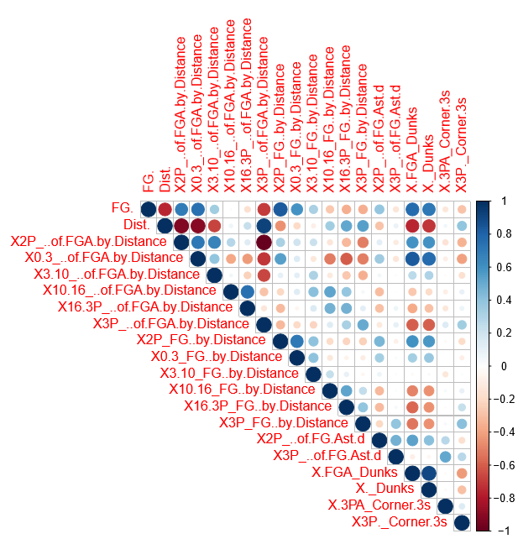
Correlation Plot

Slide 27
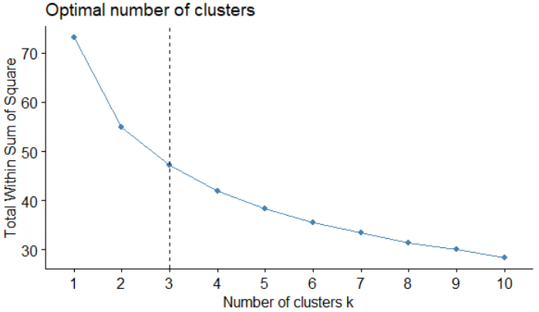
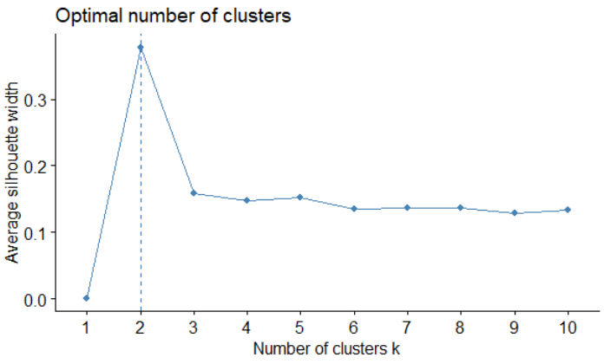
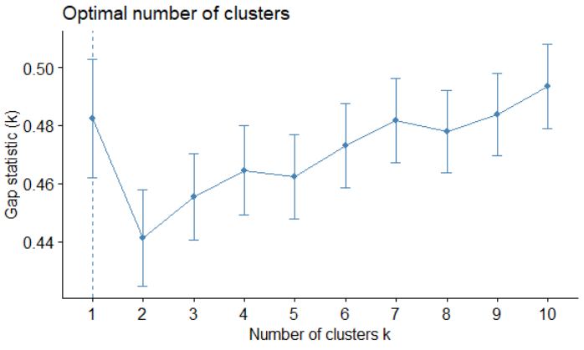
Cluster Optimization
Elbow Method
Silhouette Method
Gap Statistic Method
Optimal clusters: 3
Optimal clusters: 2
Optimal clusters: 1
3 total clusters will be used for this analysis. The Elbow Method provides the largest number of clusters between the three methods and allows for intriguing analysis moving forward.

Slide 28
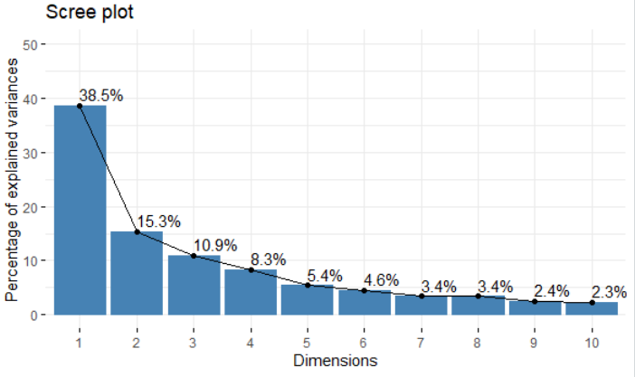
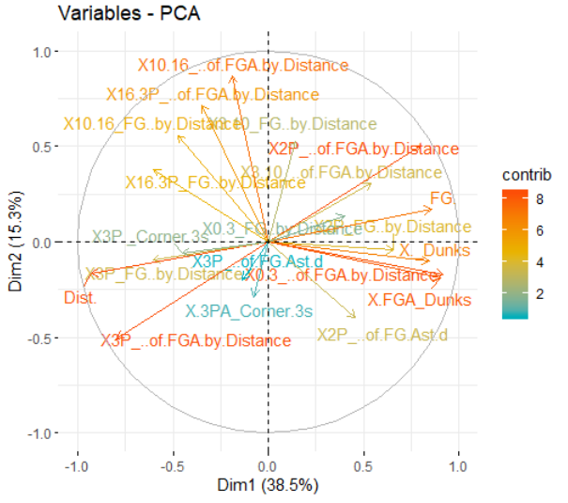
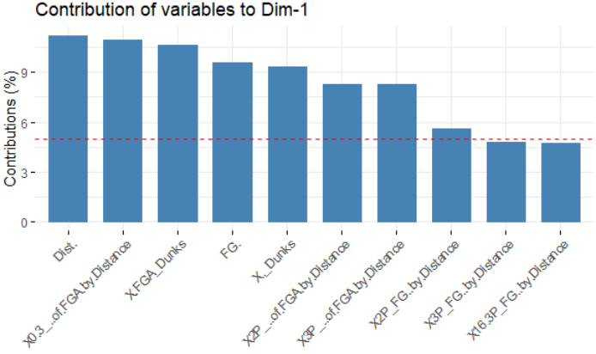
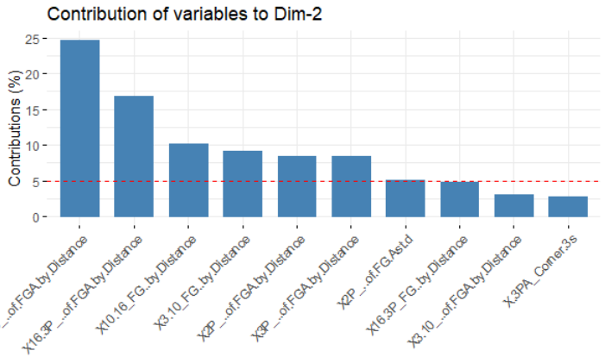
Principal Component Analysis (PCA)
Source: http://www.sthda.com/english/articles/31-principal-component-methods-in-r-practical-guide/112-pca-principal-component-analysis-essentials/

Slide 29
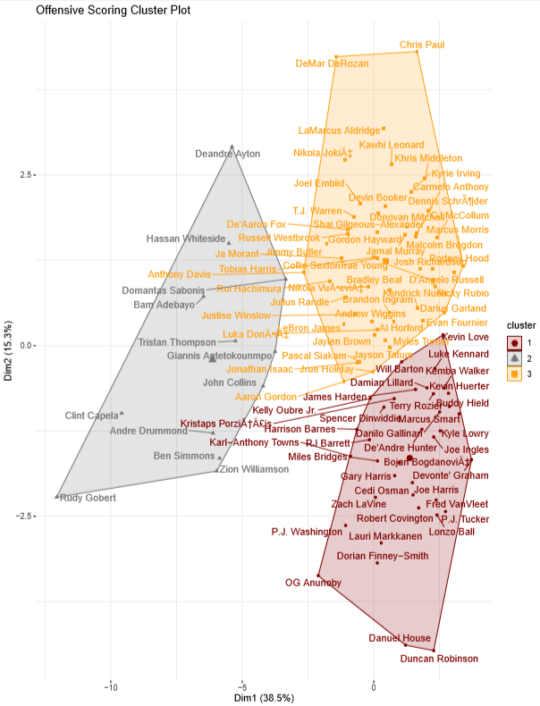
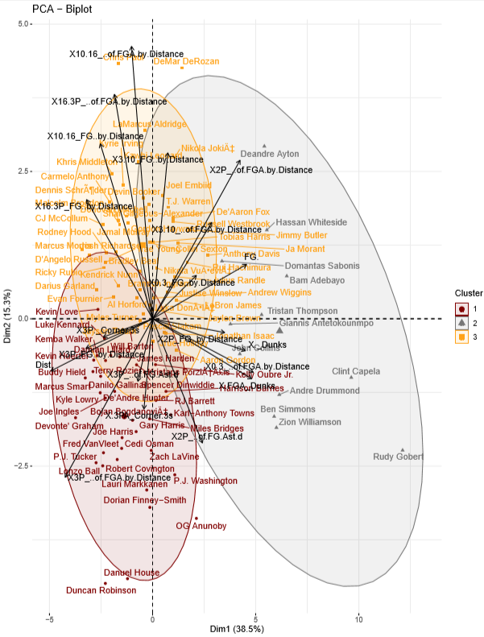
Principal Component Analysis (PCA) Plot
K-Means Clustering Plot

Slide 30
Cluster Outcomes
Cluster 1 - Name
Cluster 2 - Name
Cluster 3 - Name
Describe playing style of cluster
Describe playing style of cluster
Describe playing style of cluster
Table with significant variables
Table with significant variables
Table with significant variables

Slide 31
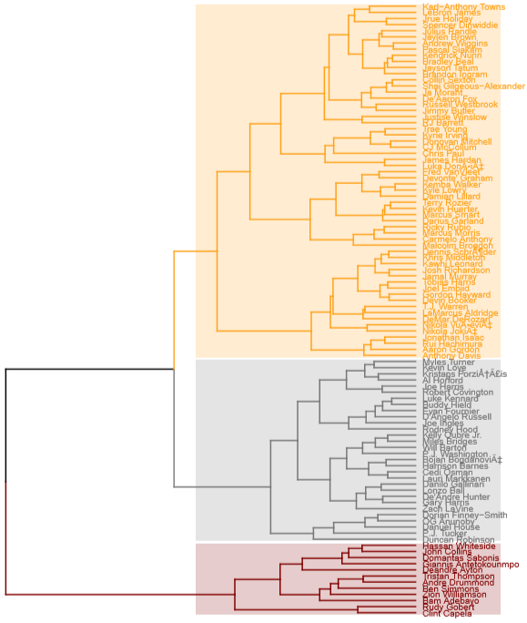
Hierarchical Cluster Analysis (HCA)
Sourcehttps://uc-r.github.io/hc_clustering

Slide 32
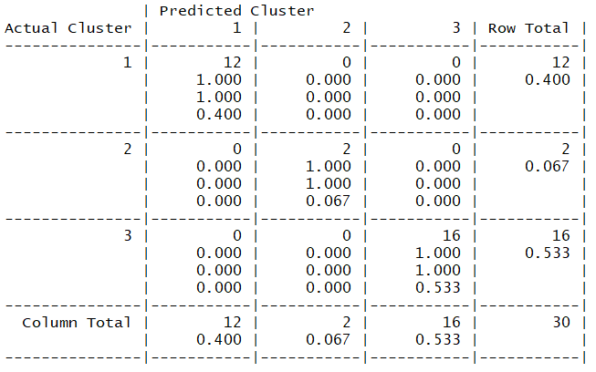
K-Nearest Neighbor (KNN)

Slide 33

Defensive Performance Clusters

Slide 34
Data Set Description
Outlook
Adjustments
Column Used for Clustering | Column Removed
Data Cleaning
Data set contained zero NA values
Data narrowed down to top 100 players by minutes played (> 29.35 minutes) for cluster analysis
All data values normalized for cluster accuracy
Feature Engineering
No additional columns added to data set
Final Data Set Dimensions
100 rows x 15 columns
Row Number
Player = Player Name
Team = Team Player Plays For
Age = Age of Player
GP = Games Played
W = Team Wins
L = Team Losses
MIN = Minutes Played Per Game
DEFA.RTG = Defensive Rating
DREB = Defensive Rebounds Per Game
DREB. = Defensive Rebound Percentage
X.DREB = Percent of Team’s Defensive Rebounds
STL = Steals Per game
STL. = Percent of Team’s Steals
BLK = Blocks Per Game
X.BLK = Percent of Team’s Blocks
OPPA.PTS_OFF.TOV = Opponent Points Off Turnovers
OPPA.PTS.2ND.CHANCE = Opponent 2nd Chance Points
OPPA.PTS.FB = Opponent Fast Break Points
OPPA.PTS.PAINT = Opponent Points in the Paint
DEF.WS = Defensive Win Shares
Data Set Dimensions: 514 rows x 21 columns
Source: https://stats.nba.com/players/defense/?sort=DEF_WS&dir=-1

Slide 35
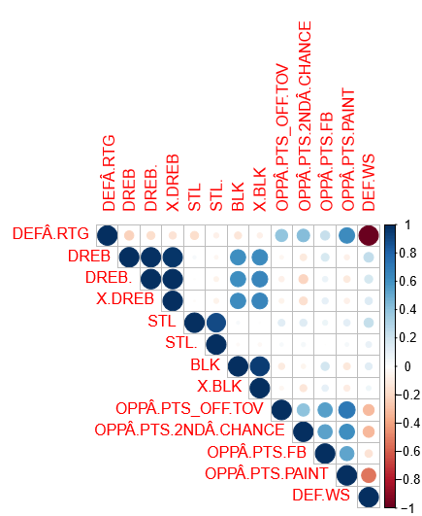
Correlation Plot

Slide 36
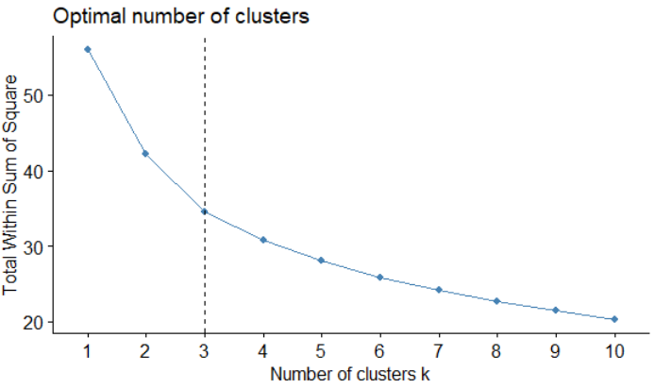
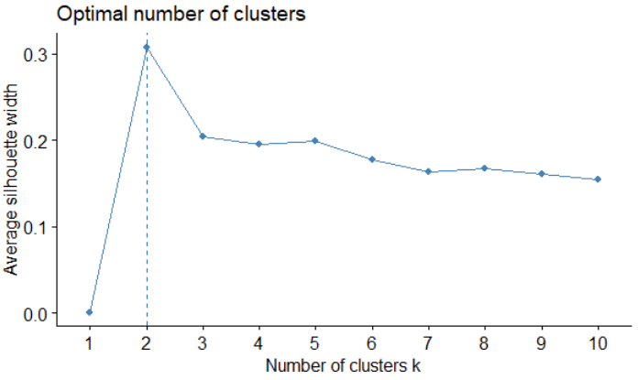
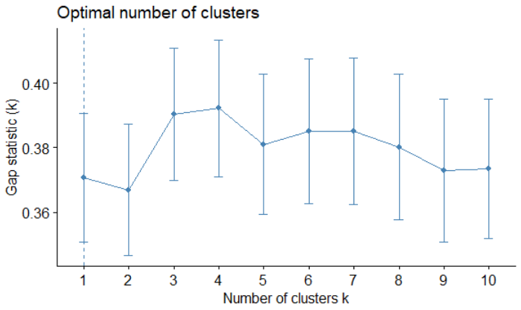
Cluster Optimization
Elbow Method
Silhouette Method
Gap Statistic Method
Optimal clusters: 3
Optimal clusters: 2
Optimal clusters: 1
3 total clusters will be used for this analysis. The Elbow Method provides the largest number of clusters between the three methods and allows for intriguing analysis moving forward.

Slide 37
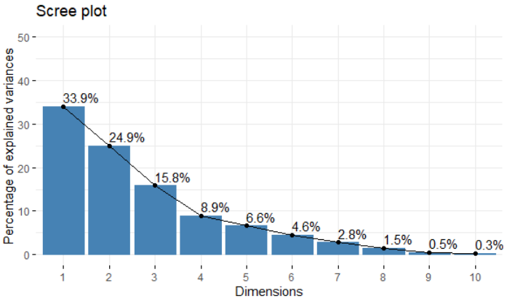
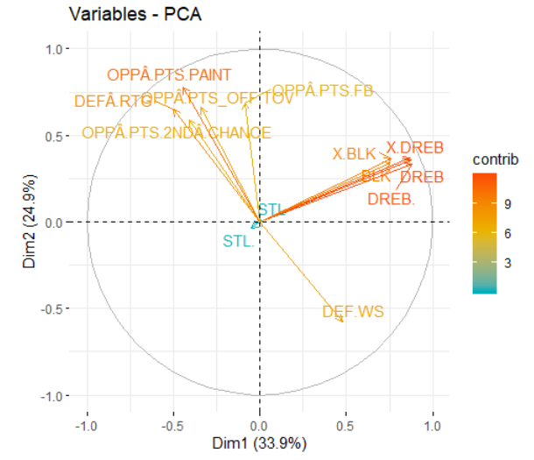
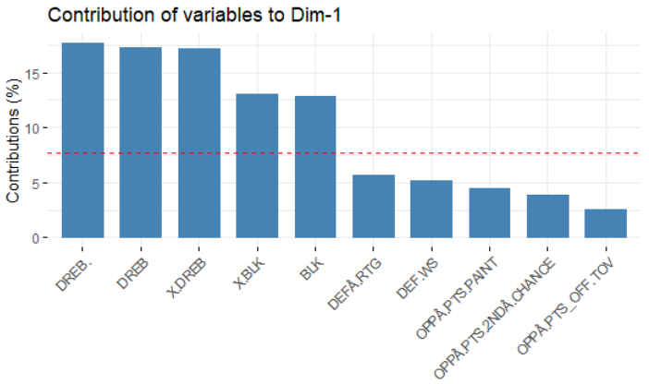
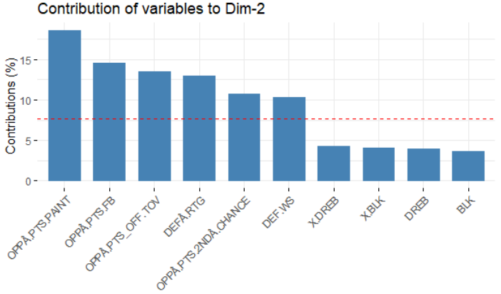
Principal Component Analysis (PCA)
Source: http://www.sthda.com/english/articles/31-principal-component-methods-in-r-practical-guide/112-pca-principal-component-analysis-essentials/

Slide 38
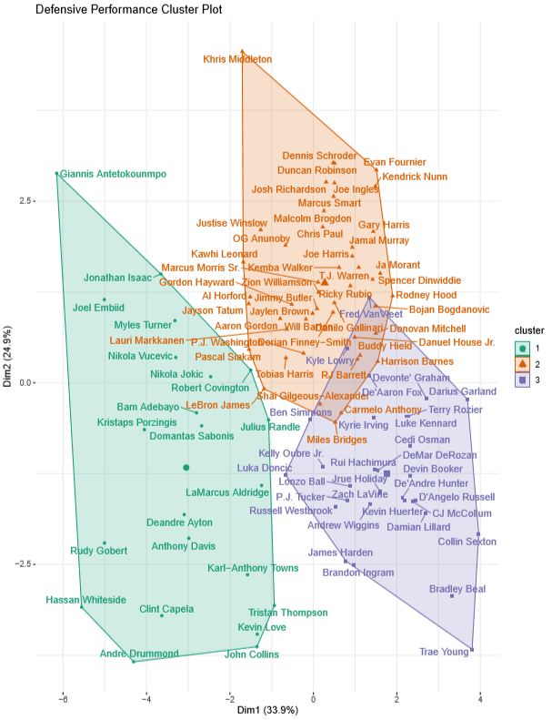
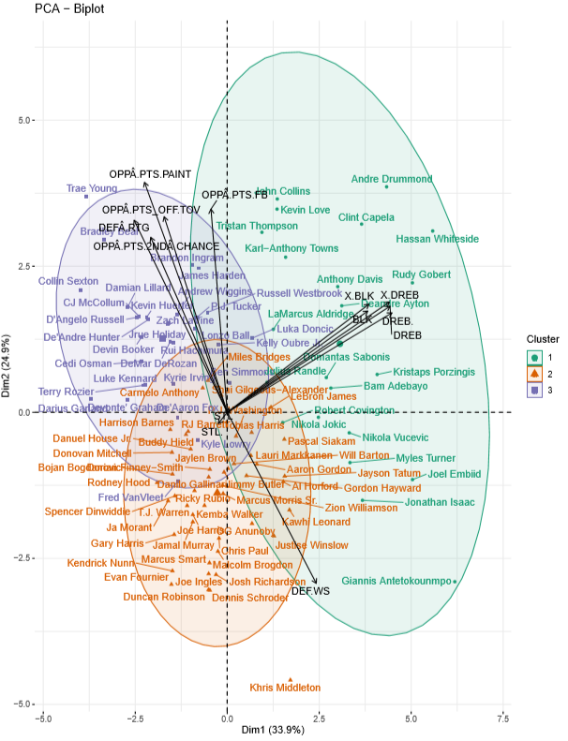
Principal Component Analysis (PCA) Plot
K-Means Clustering Plot

Slide 39
Cluster Insights
Statistical Summary
Highest Value | Middle Value | Lowest value
Statistic Category | Cluster 1 | Cluster 2 | Cluster 3
Defensive Rating | 108.80 | 107.44 | 111.96
Defensive Rebounds Per Game | 8.05 | 4.22 | 4.12
Defensive Rebound Percentage | 23.89% | 12.61% | 11.64%
Percent of Team's Defensive Rebounds | 33.97% | 18.09% | 17.13%
Steals Per Game | 0.96 | 0.97 | 1.15
Percent of Team's Steals | 18.64% | 19.38% | 21.29%
Blocks Per Game | 1.46 | 0.42 | 0.41
Percent of Team's Blocks | 42.08% | 13.02% | 11.85%
Opponent Points Off Turnovers | 11.01 | 10.42 | 12.39
Opponent 2nd Chance Points | 8.15 | 8.17 | 9.66
Opponent Fast Break Points | 9.47 | 8.57 | 10.26
Opponent Points in the Paint | 31.68 | 30.61 | 35.91
Defensive Win Shares | 0.09 | 0.11 | 0.07
All values represent averages between players within the cluster per statistic category

Slide 40
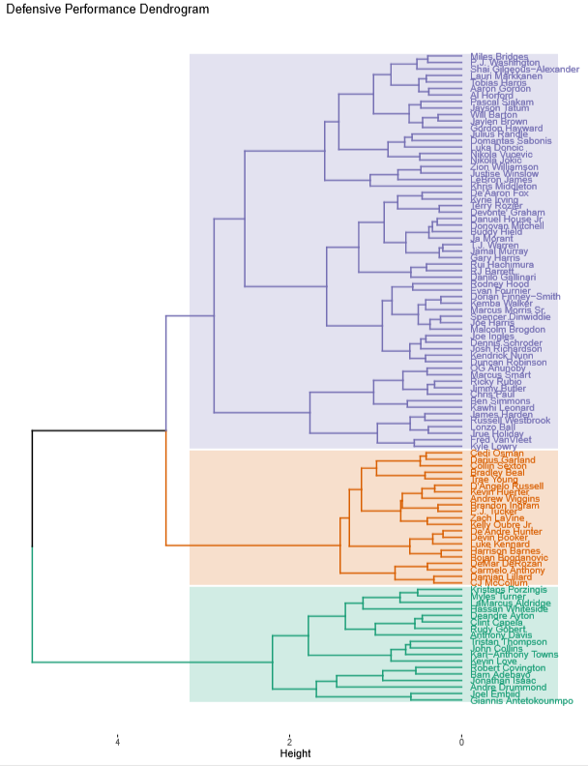
Hierarchical Cluster Analysis (HCA)
Sourcehttps://uc-r.github.io/hc_clustering

Slide 41
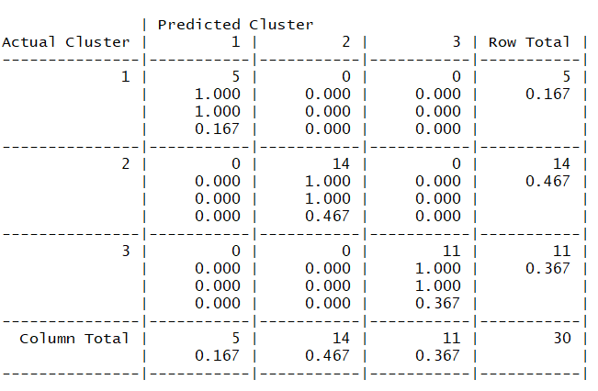
K-Nearest Neighbor (KNN)

